Slide 1
Online Bank Management
System for User’s personals financial help.
By: Vedant Rajkumar Jaiswal
Registration Number: 2019EC012
Roll No: B08
Subject: Industrial Training Seminar

Slide 2
Contents of this Project
This is a user perspective based bank managing project which can help user to take command on his financial activities.
Project name | Online Bank Managing System.
Abstract | This is a straightforward GUI-based program that is simple to grasp and utilize. The GUI is created with the Tkinter package.
Language/ technology Used | Python for main programming (GUI Based) and SQL for database.
Introduction | The Bank Management System project is written in Python. The project file contains a python script (main.py) and a database file. This is a simple console-based system that is very easy to understand and use. Talking about the system contains all the basic functions which include creating a new account, viewing the account holder's record, withdrawing and depositing the amount, balance inquiry, closing an account, and editing account details. In this mini project, there is no such login system. This means he/she can use all those available features easily without any restriction. It is too easy to use, he/she can check the total bank account records easily.

Slide 3
Table of contents
01
04
02
05
03
06
About the project
Programming Aspects
Introduction about project Idea.
Code and explanation
Major requirements
Professional Applications
Technological required aspects
Main commercial use of this project.
Project goals
Limitations and Conclusion
Desired Outputs we are expecting
Final word of appreciation

Slide 4
01
About the project
Simple Bank Managing System.

Slide 5
What is the basic idea on we working
Operation as a user
Analysis
Idea of Bank
Objective

Slide 6
About the project
Talking about the features of the Bank Management System, a user can create an account by providing the name of the account holder, and number, selecting the amount type (Saving account or Current account), and providing an initial amount more than or equal to 500. Then the user can also deposit and withdraw money just by providing his/her account and entering the amount. For the certain purpose, he/she can also check for the balance inquiry which displays the account number and amount. He/she can also view all the account holder’s lists.There’s an external database connection file used in this mini project to save users’ data permanently.

Slide 7
02
Major Requirements
Simple Bank Managing System.

Slide 8
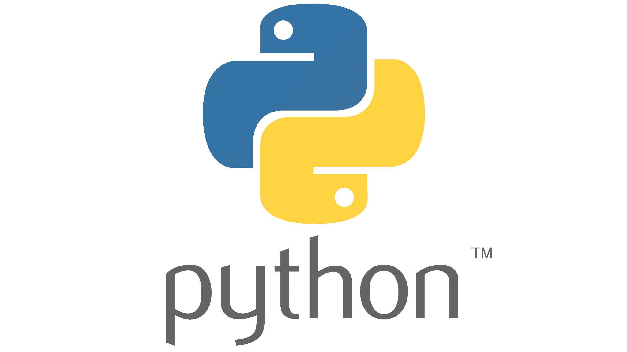

Major requirements
Programming Language
Database for Storage
We are gonna use python packages such as Tkinter, tkinter.messagebox, random and mysql.connector.
For the storage of the user’s information we need a storage bin and for that we are gonna use SQL databases which has tables to store data.

Slide 9
03
Project Goals
Simple Bank Managing System.

Slide 10
Project goals
Can Withdraw Money.
Can Deposit Money.
Cheating New Account.
Can Search account Information.
Can list the account financial status from database.
Can act as a simple bank at local for the user.

Slide 11
04
Programming Aspects
Simple Bank Managing System.

Slide 12
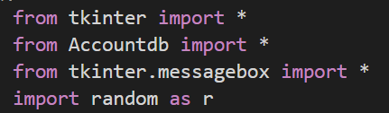
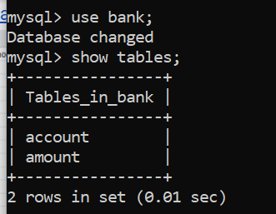
Programming Aspects
You In this programming the main programming aspects are the use GUI frames from the control based bank management system and also for storing the data that user is entering can be stored in the pre created database tables which are linked to our code by importing MySQL connection package. As far as complexity is concern GUI and sql connection is very easy to implement hence can be done on local level easily.

Slide 13
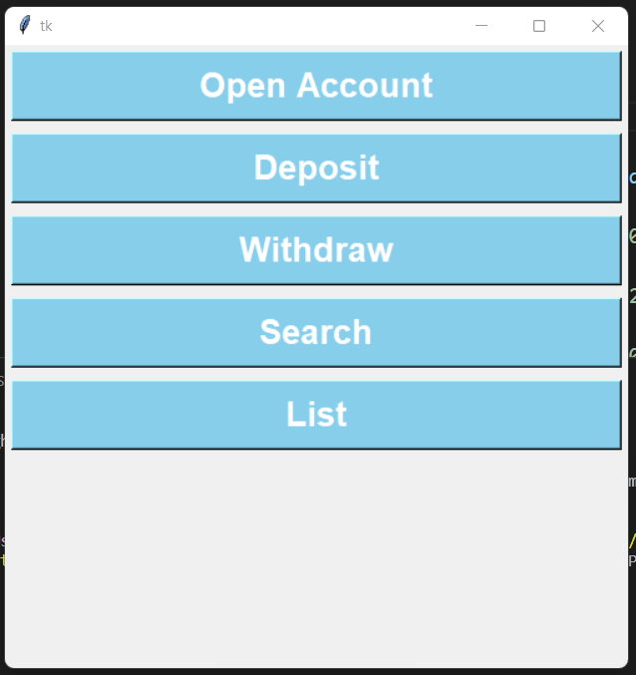
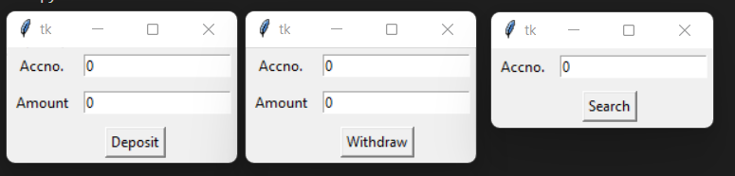
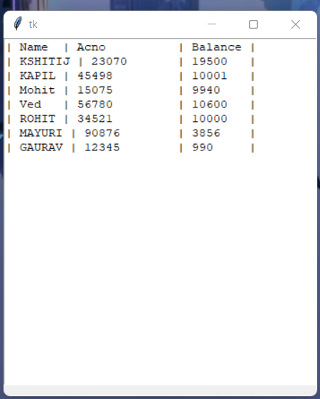
Program OUTPUTs

Slide 14
05
Professional Applications
Simple Bank Managing System.

Slide 15
Professional Applications
Simple banking Management System
E-commerce
Banking
Financial Specialist
It is an industry where banking systems were first widely used. With millions of customers and data on their online behavior, e-commerce companies are best suited to use this system.
A mass-market product that is consumed digitally by millions. Banking for the masses and SMEs are prime for managing financial activities.
Similar to banking aspects financial advisers can also use this simple system. It can loosen some pressure on them and also can help them to manage their data properly in the SQL database without losing them. Also as we are using SQL so it surely has better security and is easy for retrieval.

Slide 16
06
Limitations and Conclusion
Simple Bank Managing System.

Slide 17
Our Limitation
Our Conclusion
In terms of the banking management system, here the aspect is easy to use but the database here is stored locally so this can be a problem here, but although we solve that problem here the main issue is it's a single user based who has database access or mainly local system invariant so changing the base system requires so much unnecessary manpower.
Hence we can conclude that this banking managing system can perform the appropriate financial operations
which the user's perspective. Hence it can be more efficient but it requires input data from the user.

Slide 18



Do you have any questions?
vedant4352@gmail.com
+91 7588754316
Please keep this slide as attribution

